Slide 1
Cuisine Classification
13BCE105 – Mili Shah
13BCE130 – Naisargee Vora

Slide 2
Data
JSON file
Each training tuple contains : id, cuisine and list of ingredients
Total number of types of cuisines : 20
Total number of train tuples : 39774
Total number of test tuples : 9944

Slide 3
Example Tuple
{ "id": 24717, "cuisine": "indian", "ingredients": [ "tumeric", "vegetable stock", "tomatoes", "garam masala", "naan", "red lentils", "red chili peppers", "onions", "spinach", "sweet potatoes" ] },

Slide 4
Other details
Evaluation : accuracy
Submission format : id + cuisine

Slide 5
Model 1
Feature Engineering
Apply all classifiers and check accuracies of all classifiers on CV
Testing with best classifier as tested on CV
Randomly split train data into train and CV [70:30]
Making DTM from ingredients (ingredient as a whole)
Feature Selection

Slide 6
Model 1 – Feature Engineering
Clean the data by removing spaces, non-alphanumeric characters
Keep only nouns
By manual observations :
Keep only keywords for certain ingredients (cheese, flour, etc.)
Remove common adjectives (fresh, low fat, etc.)
Change certain keywords (lime to lemon)
Stemming and Lemmatization:
WordNet lemmatizer
Porter Stemmer
Lancaster Stemmer
English Stemmer
Noise Removal
Count of ingredients

Slide 7
Model 1 – Feature Engineering
Training with each feature engineering observation individually and testing on CV
If the accuracy obtained is higher than training with the plain model, the observation is selected and applied in the final model

Slide 8
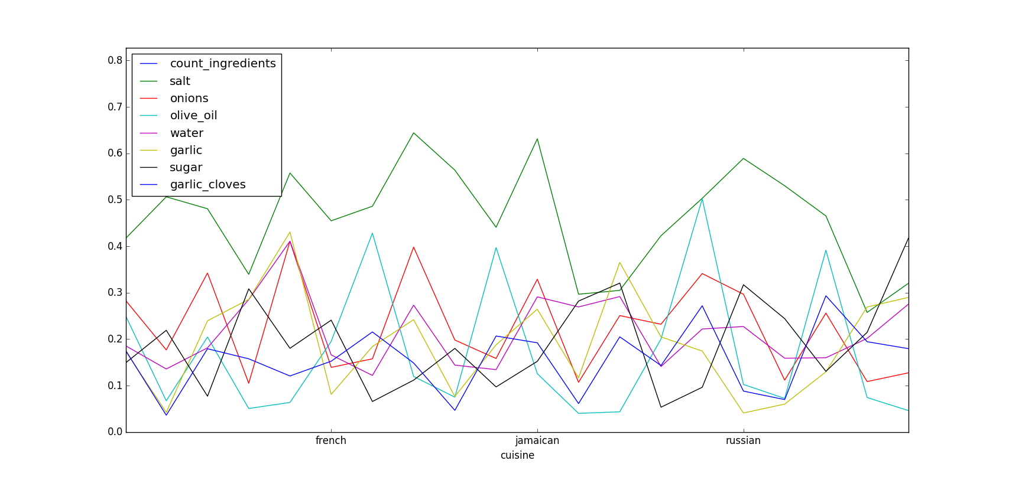
Model 1 – Noise Removal

Slide 9
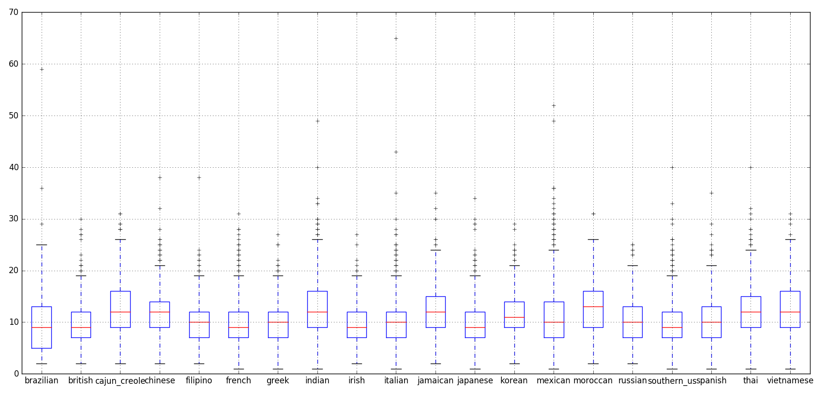
Model 1 – Count of Ingredients

Slide 10
Model 1 – Classifiers
SVM
Logistic Regression
Decision Trees
Random Forests
ADA Boost

Slide 11
Model 1 – Results
Best classifier : SVM 1
Test Accuracy : 76.881

Slide 12
Model 2 – Two-level Classification
Feature Engineering
Apply all classifiers and check accuracies through 5-fold CV and train according to the best classifier
Testing
Making DTM from ingredients (ingredient as a whole)
Group train data with similar classes
Do the previous for each sub-group

Slide 13
Model 2
 | 1 | 2 | 3
Grouping | Clustering | Manual Grouping | Manual Grouping
Classifiers | SVM, Logistic Regression | SVM, Logistic Regression | SVM, Logistic Regression, Decision Trees, Random Forests, ADA Boost
Test Accuracies | 75.08 % | 75.533 % | 75.503 %

Slide 14
Model 3
2 Differences from Model 1:
A new feature added – the first-level prediction for each tuple from the previous model
5-fold CV
Result : 76.663%

Slide 15
Model 4
1 difference from model 3 : DTM is prepared on individual words
Result : 76.438%

Slide 16
Summary
 | Model Gist | Best Test Accuracies
Model 0 | DTM on individual words | 78.369
Model 1 | Clean Keep only nouns Feature engineering by Observations | 76.881
Model 2 | Model 1 2-level classification K-fold CV | 75.533
Model 3 | Model 1 New feature – Group | 76.663
Model 4 | Model 3 DTM on individual words | 76.438
Model 5 | Model 1 DTM on individual words | 77.212
Model 6 | Model 5 Stemming and lemmatization | 77.031

Slide 17
Thank You

